Slide 1
The Impacts of Neighborhoods on Restaurant Success or Failure
The Impacts of Neighborhoods on Restaurant Success or Failure
William Brent Lander
May 14^{th,} 2019
In Partial Fulfillment of Coursera Data Science Capstone Final Project

Slide 2
Goal
Apply the tools and methodologies of data science in reducing the risk of starting a new restaurant in the greater Toronto area from neighborhood and venue selection.
Study includes :
Choice of Location (e.g., neighborhood)
Choice of venue type
Analysis of neighborhoods/venues where others have recently failed

Slide 3
Scope of Data
208 neighborhoods were examined
with 200 having existing restaurants
103 venues of restaurants
25798 individual restaurants currently in business
208 (additional) failed restaurants from 2017 & 2018
35 different venues of restaurants
69 neighborhoods

Slide 4
Sources of Data
Information Used in the Analysis for this Report Came from Open Sources on the Internet.
Demographic data came from Statistics Canada, the national statistical office, as published in 2016. Direct access to this information is no longer available outside Canada, but is reported in Wikipedia.
Geolocation information for the various neighbors came from the Nominatim geolocator service (https://nominatim.openstreetmap.org/), and was used to generate the location (latitude/longitude) for the center of each neighborhoods.
Information about existing restaurants came from the Foursquare venue API,
https://api.foursquare.com/v2/venues
This information included the location, and categoryID (or venue category) for each specific restaurant. Foursquare describes itself as “a technology platform that powers leading business solutions and consumer products through a deep understanding of location.”
Additional information on the venues’ categoryID came from the Foursquare API documentation found at https://developer.foursquare.com/docs/resources/categories
Information on restaurant closures in 2017 and 2018 came from
“The RIP LIST: 150 Toronto restaurants that closed in 2017 “ https://dailyhive.com/toronto/rip-list-toronto-restaurants-closed-2017
“The RIP LIST: 147 Toronto restaurants that closed in 2018” https://dailyhive.com/toronto/rip-toronto-restaurants-closed-2018

Slide 5
Questions Asked
What are the most successful venues of restaurants (e.g., coffee shops, ethnic restaurants, snacks) in greater Toronto?
In what neighborhoods are successful restaurants currently located?
What types of successful restaurants are located in each neighborhood?
What types of restaurants failed in the recent past?
Where did those restaurants fail?

Slide 6
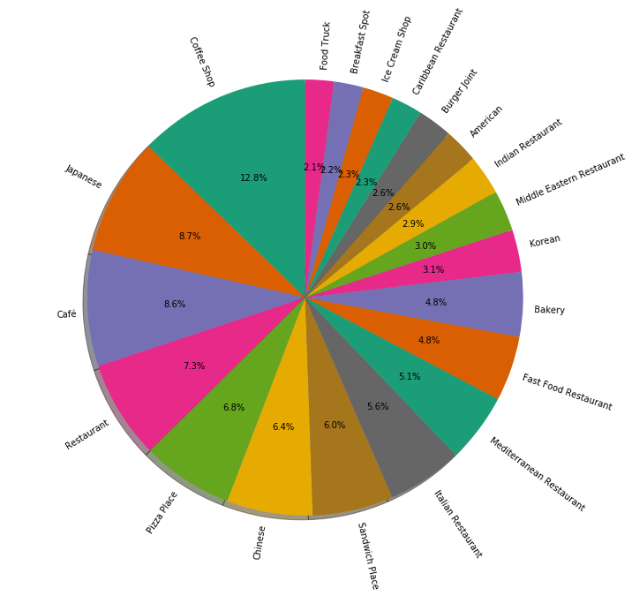
Most Successful Venues of Restaurants
Using the FourSquare Venue Categorization, Here are the 20 most common restaurant venues
More than half are short service time restaurants

Slide 7
Numbers of Most Popular Venues
Venue | Number of Restaurants
Coffee Shop | 2446
Japanese | 1661
Café | 1646
Restaurant | 1397
Pizza Place | 1296
Chinese | 1219
Sandwich Place | 1146
Italian Restaurant | 1071
Mediterranean Restaurant | 982
Fast Food Restaurant | 922
Bakery | 914
Korean | 599
Middle Eastern Restaurant | 579
American | 491
Venue | Number of Restaurants
Burger Joint | 489
Caribbean Restaurant | 441
Ice Cream Shop | 435
Breakfast Spot | 417
Food Truck | 404
Deli / Bodega | 372
Greek Restaurant | 371
Dessert Shop | 367
Bubble Tea Shop | 310
BBQ Joint | 299
Hot Dog Joint | 298
Juice Bar | 289
Fried Chicken | 227
Food Court | 215
Tea Room | 214

Slide 8
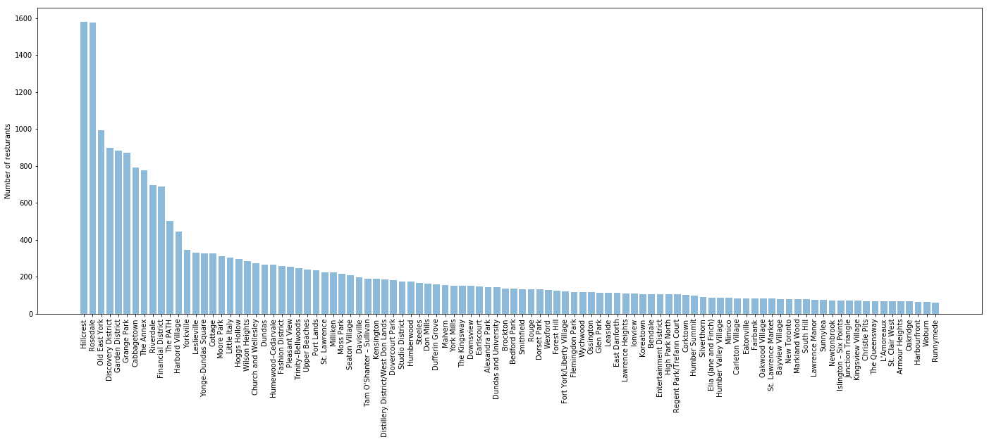
Where are the Current Restaurants
Some Neighborhoods have many more restaurants than others
The neighborhoods with the most restaurants had the most short service restaurants.
While neighborhoods, Like Hilcrest or Rosedale are Popular Restaurant Neighborhoods, They Offer the Most Competition, and a Customer Base Already Set on Existing Venues.

Slide 9
Types of successful restaurants for each neighborhood
Customer Base Expected is the Ratio of the Neighborhood Population to the Count of that Venue
Thresholded so that Unique Venues Do Not Dominate
If Business Considerations Made Starting a Tea Room Advisable, Old East York should be Considered for the Location
Complete Table Available in Report
This Table Shows Largest Customer Base.
Neighborhood | Venue | Customer Base | Current # Restaurants
Old East York | Tea Room | 8703 | 6
Woburn | Caribbean Restaurant | 8085 | 6
L'Amoreaux | Pizza Place | 7644 | 6
Malvern | Bakery | 7387 | 6
Willowdale | Coffee Shop | 7191 | 6
Elia (Jane and Finch) | Chinese | 6858 | 7
Downsview | Bakery | 6102 | 6
Newtonbrook | Chinese | 6008 | 6
Smithfield | Coffee Shop | 5833 | 6
Fairbank | Café | 5687 | 6
Riverdale | Bagel Shop | 5168 | 6
Bendale | Restaurant | 4824 | 6
Humewood–Cedarvale | Fast Food Restaurant | 4586 | 6
Tam O'Shanter - Sullivan | Caribbean Restaurant | 4539 | 6
Milliken | Pizza Place | 4379 | 6
Neighborhood | Venue | Customer Base | Current # Restaurants
West Hill | Fast Food Restaurant | 4272 | 6
Steeles | Pizza Place | 4116 | 6
Forest Hill | Portuguese Restaurant | 4009 | 6
Davisville | Sandwich Place | 3955 | 6
Leslieville | Mediterranean Restaurant | 3928 | 6
High Point North | Restaurant | 3791 | 6
York University Heights | Pizza Place | 3734 | 7
Scarborough Junction | Fast Food Restaurant | 3683 | 7
Don Mills | Burger Joint | 3562 | 6
Flemingdon Park | Restaurant | 3548 | 6
Upper Beacges | Snack Place | 3305 | 6
Eglinton East | Pizza Place | 3198 | 7
Eatonville | Chinese | 3189 | 6
Glen Park | Coffee Shop | 3071 | 6
East Danforth | Indian Restaurant | 3063 | 7

Slide 10
Recent Restaurant Failures - Where
Success of a Restaurant Requires the Right Venue in the Right Neighborhood
A Number of Factors Can Keep a Neighborhood from Being Right for Any to the Success of a Restaurant, for example:
Crime Statistics Difficult Access
Expensive Costs
Competition with Existing Restaurants
This Table Shows the Number of Restaurant Failures by Neighborhood for 2017 & 2918
These Neighborhoods should be avoided
The full list is in the report.
Neighborhood | Restaurant Failures
Yorkville | 21
Chinatown | 18
Little Italy | 17
Alexandra Park | 14
The Annex | 8
The Danforth | 7
The Beaches | 7
Cabbagetown | 7
Riverdale | 6
Leslieville | 6
Little Portugal | 5
Roncesvalles | 4
Fort York/Liberty Village | 4
Church and Wellesley | 4

Slide 11
Matching Venue to Neighborhood
Several neighborhoods stood out as having the most closing in a specific venue.
Each of these Neighborhoods is known as a having a specific focus.
This demonstrates the expected result from starting a restaurant in a neighborhood with established competitors.
Neighborhood | Most Common Closing Venue
Yorkville | Seafood Restaurant
Chinatown | Chinese
Little Italy | Italian Restaurant
Alexandra Park | Italian Restaurant

Slide 12
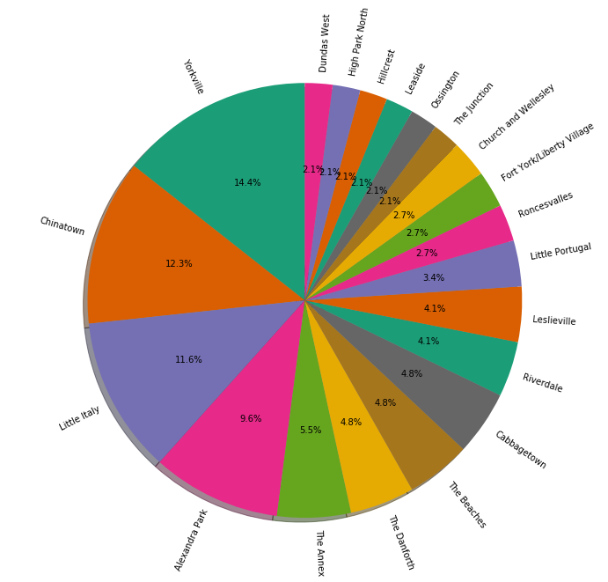
Another Way to View Restaurant Closings
The Top Neighborhoods for Restaurant Failures in 2017 & 2018
Not all Neighborhoods are Equally Likely to see a Restaurant Close.
Selecting one of the Double-Digit Neighborhoods can Increase the Risk for a new Restaurant.

Slide 13
Conclusions
Decision factors in starting a new restaurant, with selection of neighborhood and venue is a very complex, and risky. Many of the decision factors are covered in this report. Many additional factors, such as master chef, experience in a particular venue, financial backing, and experience in starting other restaurants must also be considered.
Once other Choices are Made, this Report Gives Guidance on Selecting the Proper Neighborhood
Toronto Canada numbers reflect a strong base of customers. The number of successful restaurants which have a unique venue (e.g., Hungarian Restaurants) shows a potential opening for niche restaurants. However, many popular venues are grouped into neighborhoods (e.g., Little Italy, Koreatown, Chinatown), where competition all but prohibits a new, competing, venue.
Incomplete data, and limited information on certain venue types, increases the risk inherit in recommendations. The number of neighborhoods, restaurants, and venues is smaller than those typically used in data science.

